Slide 1

NUMBER OF VAL
NUMBER OF VALID MOVE COMBINATION ON CHESSBOARD
Submitted by
A. Surya(192211797) Under the Supervision of Dr. R. Dhanalakshmi
Chess is a game of strategy and tactical brilliance. This presentation explores the fascinating concept of move combinations in chess and their implications.
Notes:
1

Slide 2

NUMBER OF VALID MOVE COMBINATION ON CHESSBOARD

Slide 3
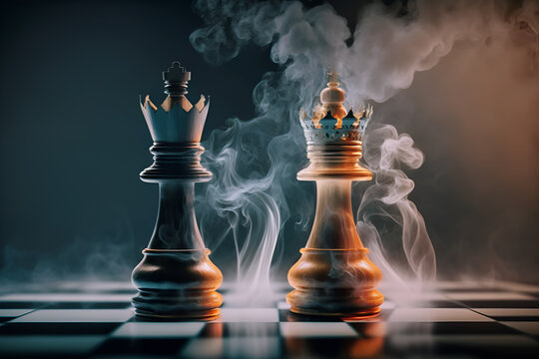
The Chessboard: A Realm of Possibilities
Dimensions
The chessboard is an 8x8 grid with alternating light and dark squares. It provides the spatial framework for the game.
Squares
Each square on the board has a unique coordinate based on its row and column. For example, the top-left square is called A1, while the bottom-right square is H8.
Notes:
3

Slide 4

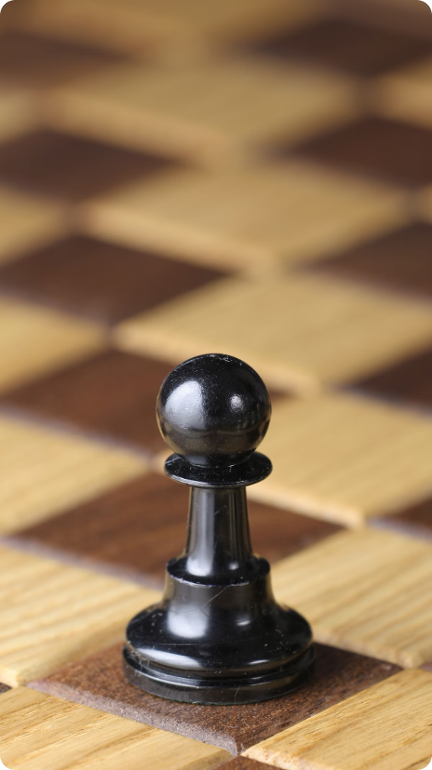
Legal Moves for Each Piece
1
Pawn
2
Rook
The pawn is the most numerous piece, moving forward one square at a time. On its first move, it can move two squares forward. Pawns can also capture diagonally forward.
The rook moves horizontally or vertically along any number of unoccupied squares. It is a strong piece for controlling open files and ranks.
3
Knight
4
Bishop
The knight is the most unique piece, moving in an "L" shape - two squares in one direction and then one square perpendicularly. It is the only piece that can jump over other pieces.
The bishop moves diagonally along any number of unoccupied squares. It is restricted to squares of the same color (light or dark).
Notes:
4

Slide 5

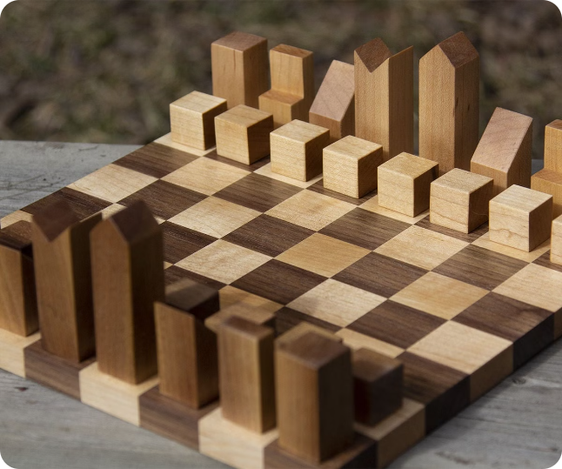
Calculating Possible Move Combinations
Piece
Average Moves
Total Moves
Pawn
2
16
Rook
7
56
Knight
8
64
Bishop
7
56
Queen
14
112
King
8
64
Notes:
5

Slide 6
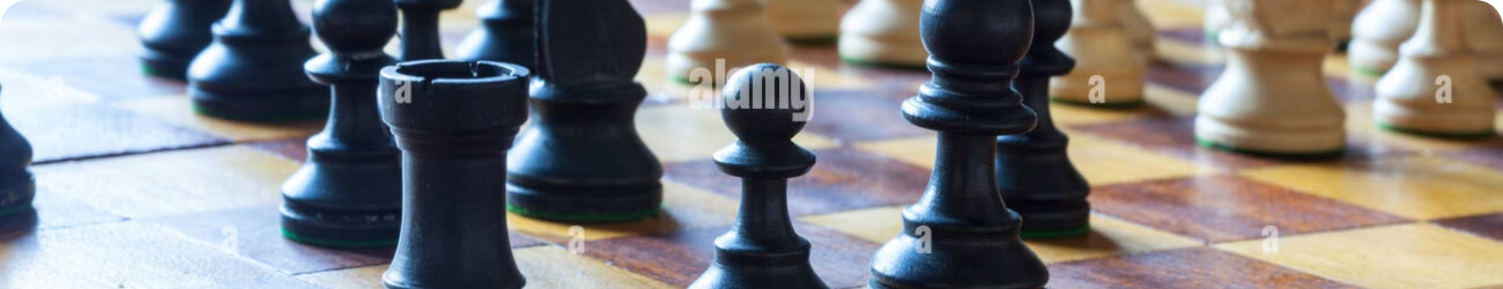
Factors Affecting Valid Combinations
Piece Placement
Opponent's Pieces
Castling
The position of each piece on the board greatly affects the number of valid moves. For example, a rook on an open file has more potential moves than a rook trapped behind other pieces.
The presence of the opponent's pieces can block moves or create threats. This significantly impacts the number of valid move combinations for each player.
Castling is a special move involving the king and a rook. It allows for a quick and strategic repositioning of the king, increasing the number of possible moves.
Notes:
6

Slide 7


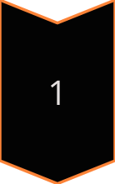
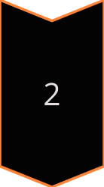
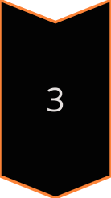
Techniques for Enumerating Valid Combinations
Recursive Algorithms
Recursive algorithms can systematically explore all possible moves for each piece, considering the current board state.
Minimax Search
Minimax search is a game-tree search algorithm that evaluates possible moves based on their potential to maximize the player's gain or minimize the opponent's gain.
Pruning Techniques
Pruning techniques, such as alpha-beta pruning, are used to reduce the search space by eliminating moves that are unlikely to lead to optimal results.
Notes:
7

Slide 8

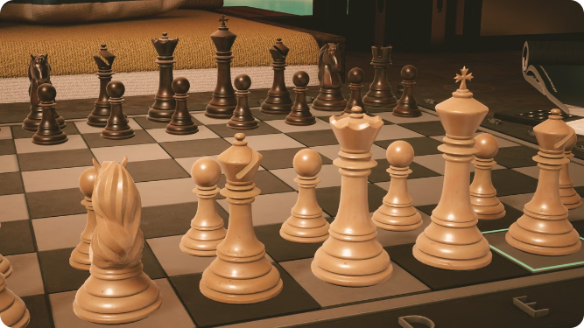



Applications of Chess Move Combination Analysis
Chess Engines
Chess engines use move combination analysis to evaluate positions and select the best moves. They are used by both amateur and professional players.
Chess Strategy
Understanding move combinations is crucial for developing effective chess strategies. Players can analyze different scenarios to identify weaknesses and opportunities.
Artificial Intelligence
Chess move combination analysis is a fundamental aspect of artificial intelligence research. It has been used to develop algorithms for problem solving and decision-making.
Notes:
8

Slide 9

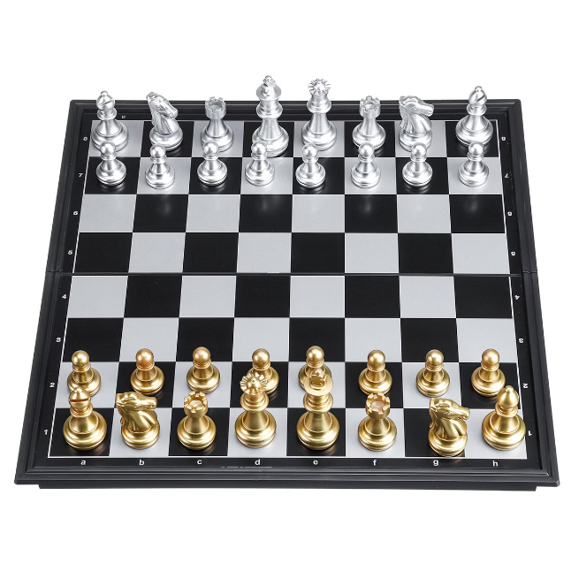
Conclusion: Unlocking the Power of Chess
The analysis of chess move combinations reveals the complexity and elegance of this timeless game. By understanding the underlying principles, players can gain a deeper appreciation for the strategic depths of chess.
Notes:
9

Slide 10

NUMBER OF VAL

